Slide 1
Power BI
beginners free 10 weeks online training course

Slide 2
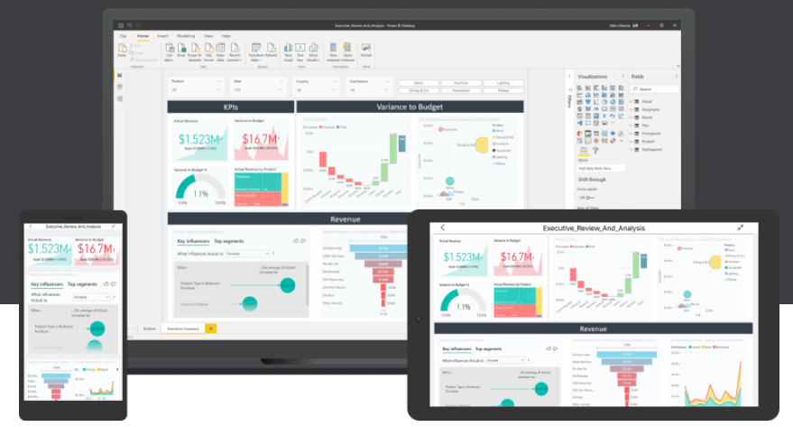

Power BI
beginners free 10 weeks online training course

Slide 3
Power BI Week 1
Monday 18th Jan 2021
Introduction to Power BI and your first Power BI report.
Hi & Intros: David, Conrad
Logistics: Classroom course
Recording on Youtube. Leave if not happy to be recorded
Each week sign up on Meetup.com for the weekly event & Q&A workshop
Each session will be a new Zoom link
Questions into the chat or raise your hand
2 screens is better than 1.
Microphones on mute

Slide 4







David Moss
Azure | Power Platform | D365 Solutions Architect
Delivering end to end Azure AI & BI hybrid solutions with a passion for D365, Power Platform & Power BI reports across IoT, e-commerce, telcos, fintech & manufacturing verticals.
MVP Data Platform
Since 2017 awarded MVP - Microsoft Valued Professional - for my community contributions.
Leader of Power BI meetup user groups in London and online.
Community & conference presenter.
ACMA, CGMA Accountant
@wottabyte
A qualified ACMA accountant all my career which keeps me commercially aware & business facing partner on D365 F&O projects.
wottabyte
www.wottabyte.com
Notes:
Hand out cards & stickers

Slide 5


Conrad Moss : Power BI Developer
Certified MCSA BI Reporting : Power BI & Excel
Power BI Certification 70-778 preparing to take DA-100
Manchester United fan

Slide 6

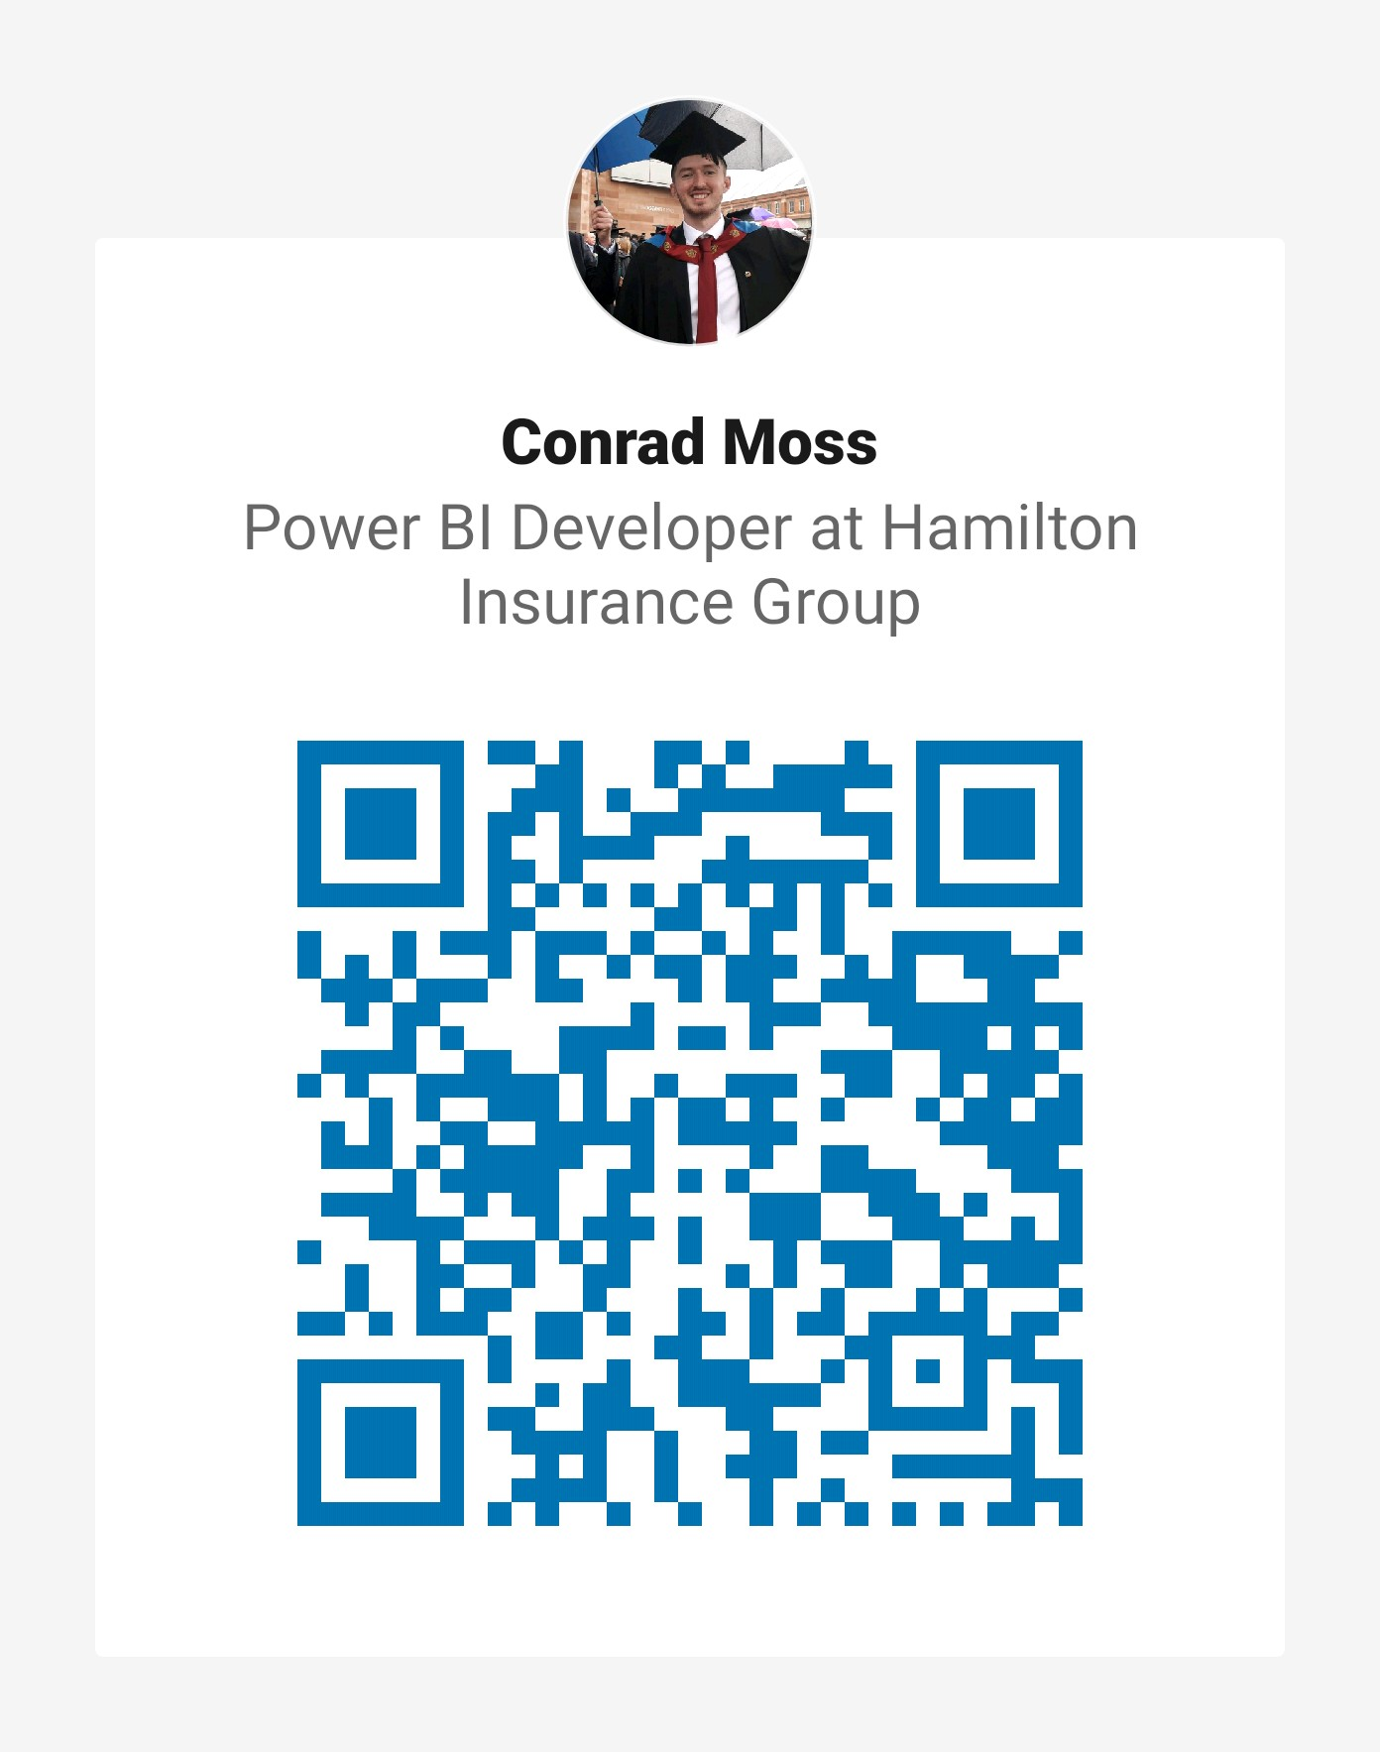
Linkedin : QR Codes

Slide 7
Power BI
beginners free 10 weeks online training course
Week 1: Monday 18th Jan 2021 : Introduction to Power BI and your first Power BI report.
Week 2: Monday 25th Jan 2021 : Use Power Query Editor to get data & prepare your data.
Week 3: Monday 1st Feb 2021 : Use Power BI desktop to structure & create datamodels.
Week 4: Monday 8th Feb 2021 : Design & configure Power BI visuals like charts, maps & KPIs.
Week 5: Monday 15th Feb 2021 : Add user friendly report navigation features, slicers & tooltips.
Week 6: Monday 22nd Feb 2021: Publish & share Power BI reports & dashboards.
Week 7: Monday 1st March 2021: Get to grips with Power BI cloud service & mobile features.
Week 8: Monday 8th March 2021: Enhance your data with DAX for KPIs reporting.
Week 9: Monday 15th March 2021: Data analytics reporting & AI features in Power BI.
Week 10: Monday 22nd March 2021: Power BI at work with workspaces, datasets & security.

Slide 8
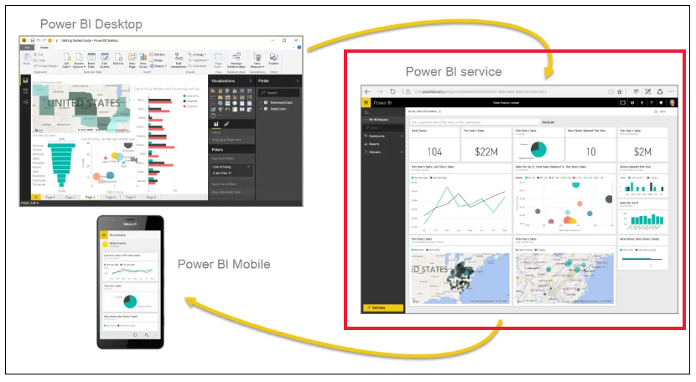
What is Power BI ?

Slide 9
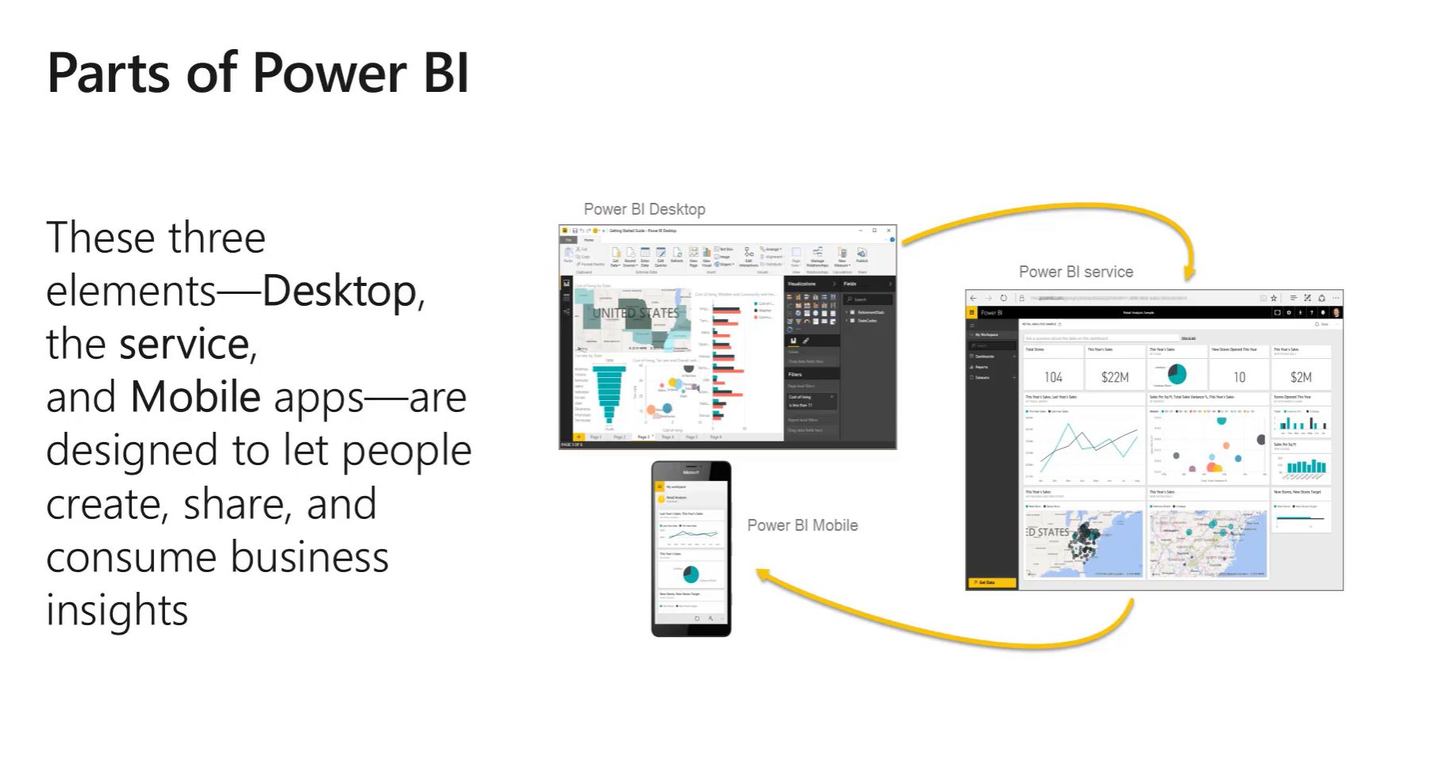
PBI Desktop, PBI Service, PBI Mobile apps

Slide 10
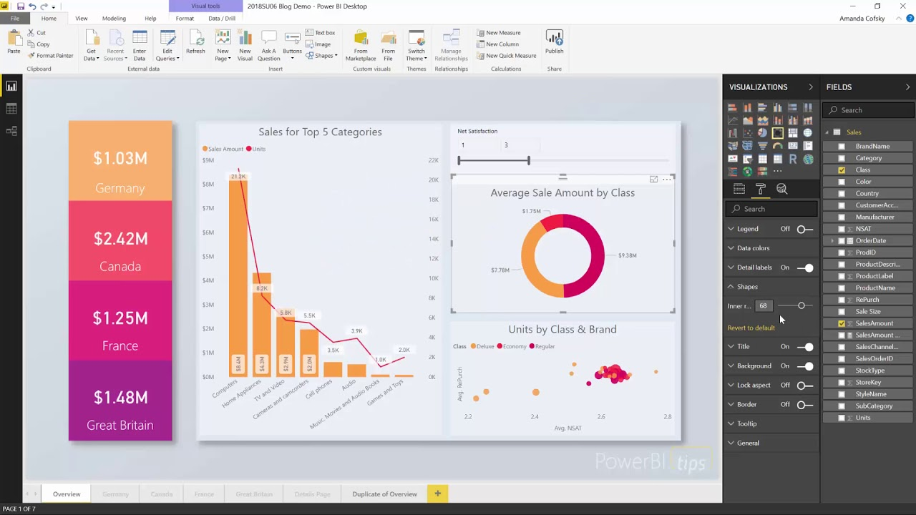
Notes:
Power BI Desktop … Installed ?

Slide 11
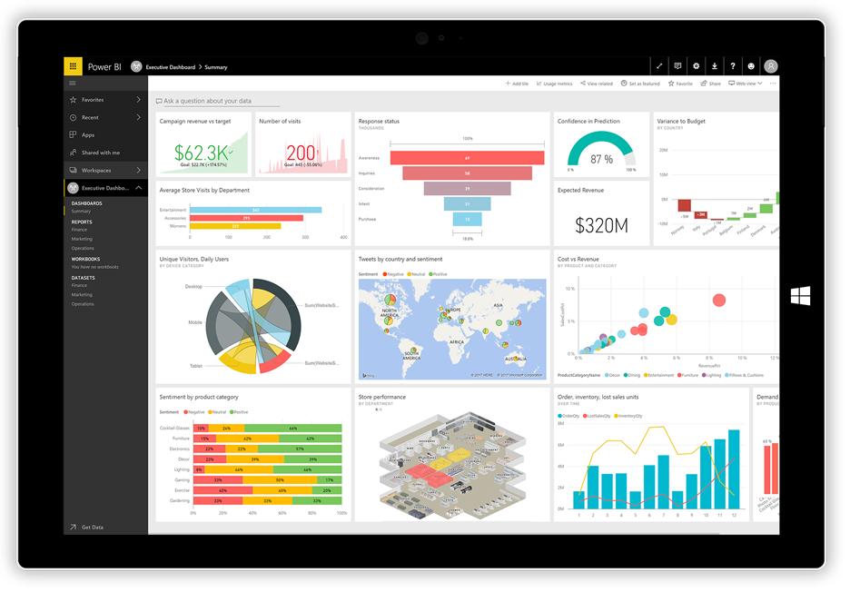
Notes:
Power BI Dashboard

Slide 12

Quick Survey of audience
https://forms.office.com/Pages/ResponsePage.aspx?id=WkuituyrDEaGarPmYT9Z1NvMNOjKOFdHsnEJjP6WpoNUREdYRjdPUUQ0SzlQVzYzUEdJSkVKV1U5Ni4u
Student go to form and submit
Trainer display live online results in Power BI dashboard

Slide 13
Power BI Desktop
Download Power BI Desktop from www.powerbi.com
Install
Build your first report - use blog next page
Quick look at PBI Desktop features
Save your report as .pbix
Get a Microsoft account
Publish to Power BI Service app.powerbi.com
Workshop this eve at 21:00 – 22:00 for 1-2-1 help.

Slide 14
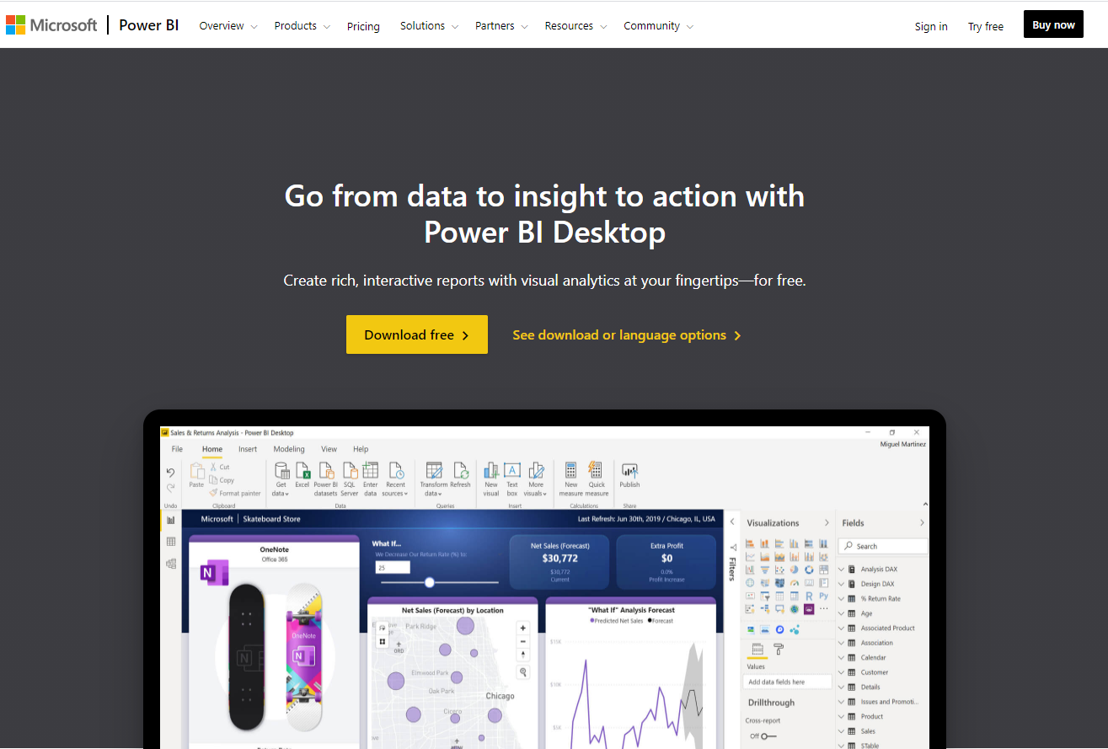
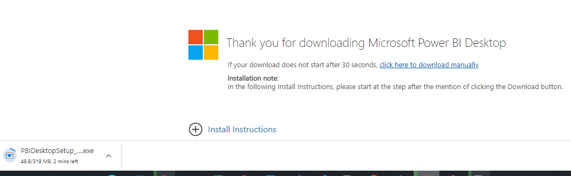
Power BI Desktop
Download Power BI Desktop
Windows Store - W10 app
Or Download desktop version
32 bit or 64 bit
Windows not Apple
What is PBI desktop ?
https://docs.microsoft.com/en-us/power-bi/fundamentals/desktop-getting-started

Slide 15
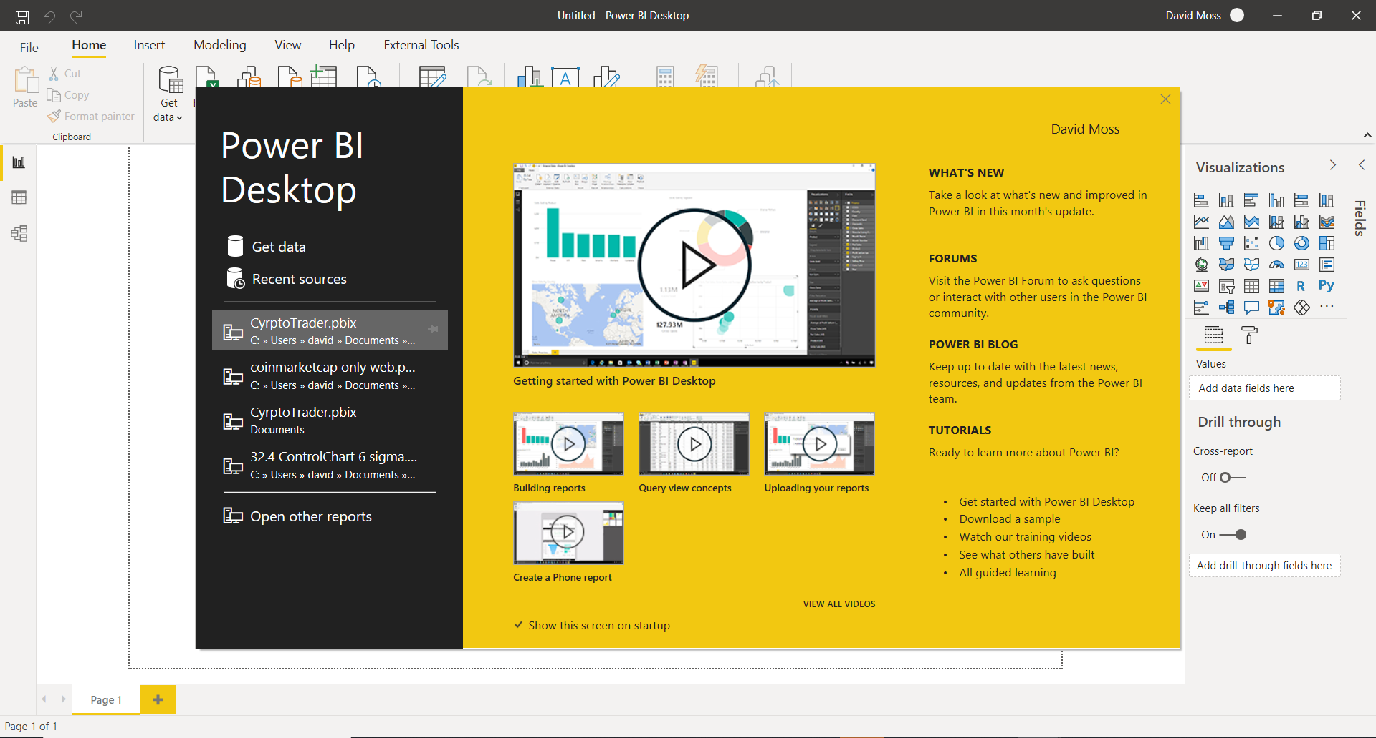

Slide 16
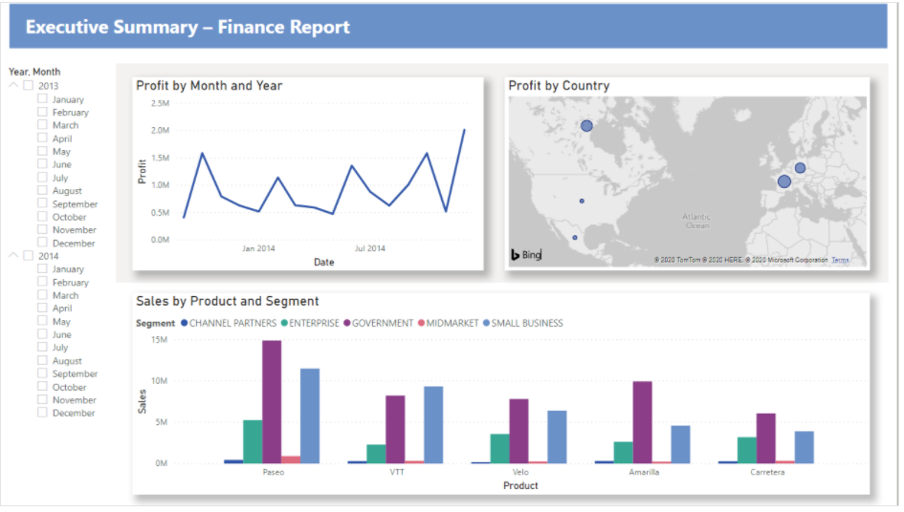
Lesson 1 - build your first report
https://docs.microsoft.com/en-us/power-bi/create-reports/desktop-excel-stunning-report

Slide 17
Publish to www.powerbi.com
Sign in at www.powerbi.com
You need a MS a/c not gmail !!
https://docs.microsoft.com/en-us/power-bi/fundamentals/service-self-service-signup-for-power-bi

Slide 18

Workshop this eve at 21:00 – 22:00 GMT
Q&A Workshop - Power BI Beginner Training Lesson 1
https://www.meetup.com/The-Power-BI-Apprentice/events/275805195/

Slide 19
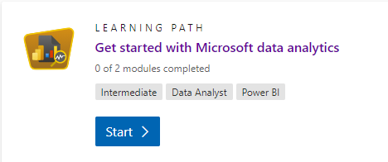
Preparation for next week
Microsoft Learn : https://docs.microsoft.com/en-us/learn/certifications/exams/da-100
Get started with MS data analytics https://docs.microsoft.com/en-us/learn/paths/data-analytics-microsoft/
Microsoft documentation : https://docs.microsoft.com/en-us/power-bi/learning-catalog/

Slide 20
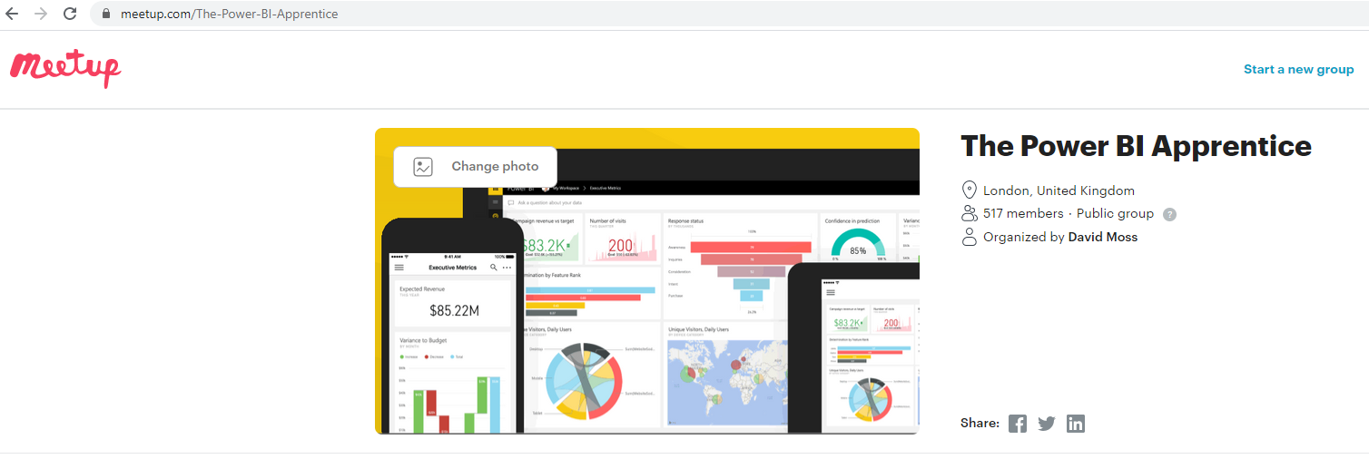
Social Media : Meetup , LinkedIN, YouTube

Slide 21
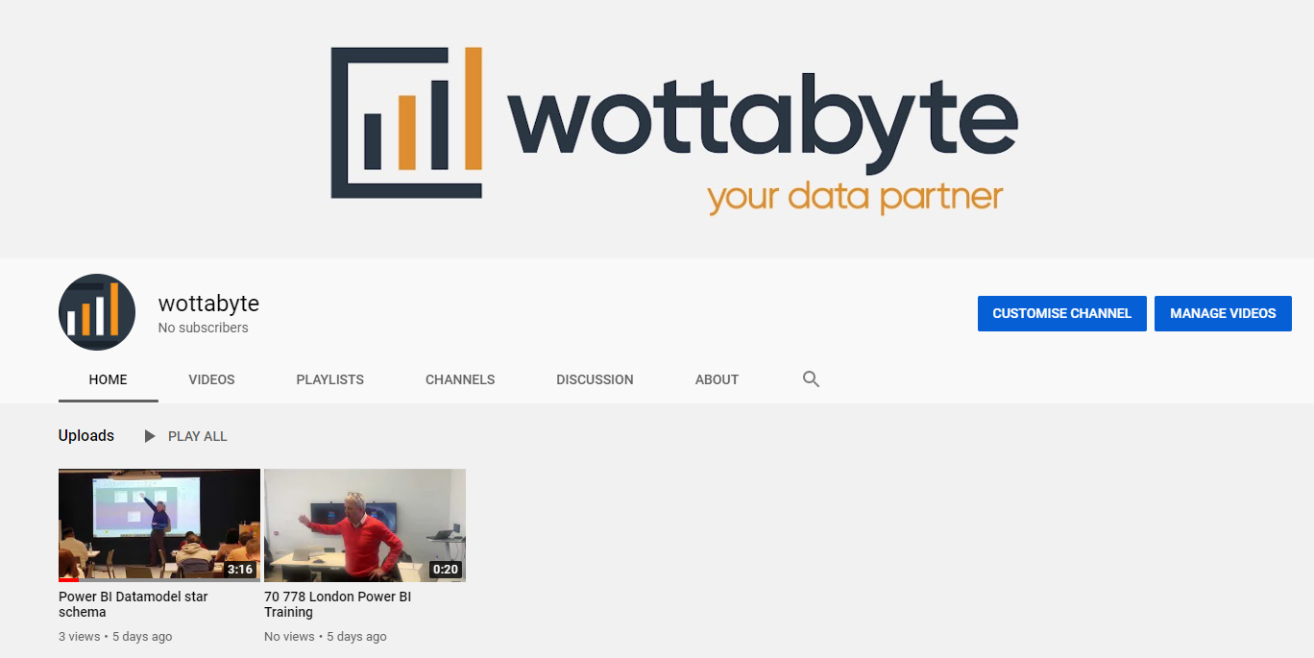
You Tube
https://www.youtube.com/channel/UCDtmmwK3YxWqzDNZ5L3pdMw

Slide 22

The End

Slide 23
















Slide 24
Power BI – LESSON 2 of 10
beginners free 10 weeks online training course

Slide 25
Power BI Week 2
Monday 25th Jan 2021
Use Power Query Editor to get data & prepare your data
Hi & Intros: David & Conrad
Logistics: Classroom course
Recording on Youtube. Leave if not happy to be recorded
Each week sign up on Meetup.com for the weekly event & Q&A workshop
Each session will be a new Zoom link
Questions into the chat or raise your hand
2 screens is better than 1.
Microphones on mute
Workshop at 21:00 : register now at https://www.meetup.com/The-Power-BI-Apprentice/events/

Slide 26
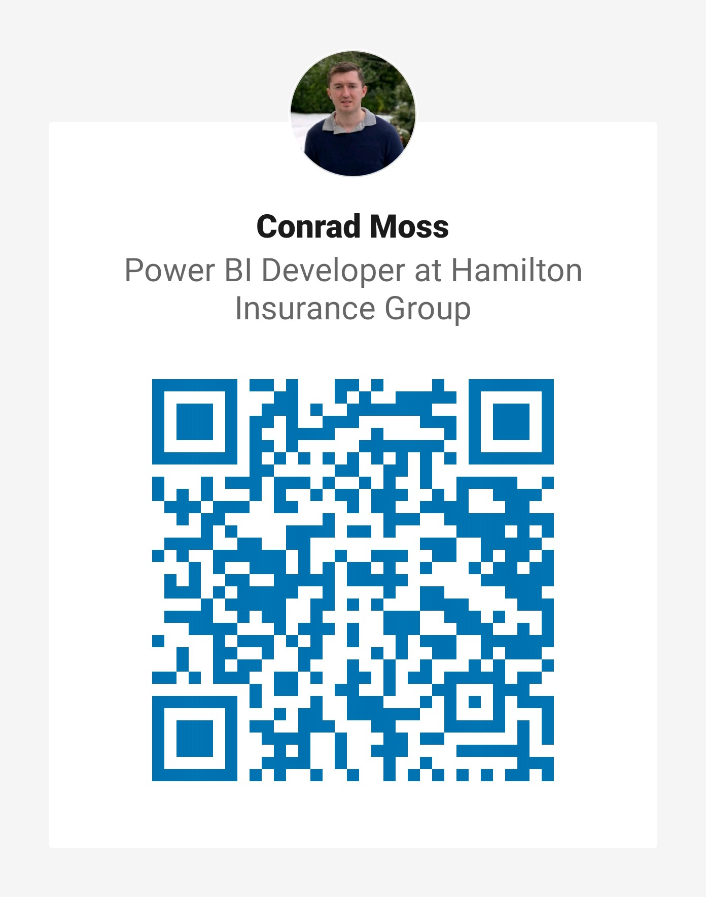
Linkedin : QR Codes

Slide 27
Power BI
beginners free 10 weeks online training course
Week 1: Monday 18th Jan 2021 : Introduction to Power BI and your first Power BI report.
Week 2: Monday 25th Jan 2021 : Use Power Query Editor to get data & prepare your data.
Week 3: Monday 1st Feb 2021 : Use Power BI desktop to structure & create datamodels.
Week 4: Monday 8th Feb 2021 : Design & configure Power BI visuals like charts, maps & KPIs.
Week 5: Monday 15th Feb 2021 : Add user friendly report navigation features, slicers & tooltips.
Week 6: Monday 22nd Feb 2021: Publish & share Power BI reports & dashboards.
Week 7: Monday 1st March 2021: Get to grips with Power BI cloud service & mobile features.
Week 8: Monday 8th March 2021: Enhance your data with DAX for KPIs reporting.
Week 9: Monday 15th March 2021: Data analytics reporting & AI features in Power BI.
Week 10: Monday 22nd March 2021: Power BI at work with workspaces, datasets & security.

Slide 28

Power BI Week 2
Monday 25th Jan 2021
1st a quick QUIZ !! www.mentimeter.com
50 24 12 1
https://www.menti.com/csb5wsjst2

Slide 29
Power BI Week 2
Monday 25th Jan 2021
1st lets finish of Lesson 1
Complete Power BI report from Lesson 1
Sign up & login for Power BI Service account (needs a Microsoft a/c)
Publish report to the Power BI service
Explain what is Power BI Service basics
Navigate report in Power BI Service
Back to get & prepare data with Power Query Editor

Slide 30
Complete Power BI report from Lesson 1
Open blog https://docs.microsoft.com/en-us/power-bi/create-reports/desktop-excel-stunning-report
Demo a step
Show finished report
Save Power BI desktop report as .pbix locally
Conrad demo

Slide 31
What is Power BI ?

Slide 32
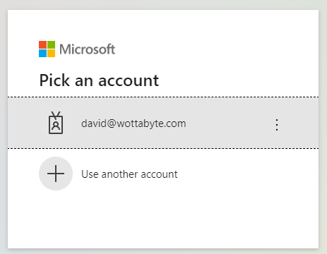
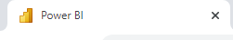
Create a Power BI Service account
Sign up & login with Power BI account (needs a Microsoft a/c)
Goto www.powerbi.com and click ‘Sign in’. Free license.
Work or school a/c ? If none then create a Microsoft a/c but cannot use a gmail. https://docs.microsoft.com/en-us/power-bi/consumer/end-user-sign-in
If fails we can help you during the workshop later this eve.
Show Power BI Service Home page My workspace is blank.
Help @ Workshop if needed or read https://docs.microsoft.com/en-us/power-bi/fundamentals/service-self-service-signup-for-power-bi

Slide 33

Workshop this eve at 21:00 – 22:00 GMT
Monday 25th Jan 2021
Q&A Workshop - Power BI Beginner Training Lesson 2 of 10
https://www.meetup.com/The-Power-BI-Apprentice/events/275871416/

Slide 34
Quick Survey of audience
https://forms.office.com/Pages/ResponsePage.aspx?id=WkuituyrDEaGarPmYT9Z1NvMNOjKOFdHsnEJjP6WpoNUREdYRjdPUUQ0SzlQVzYzUEdJSkVKV1U5Ni4u
Student go to form and submit
Trainer display live online results in Power BI dashboard

Slide 35
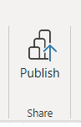

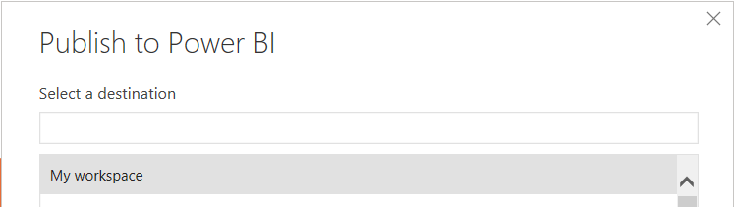
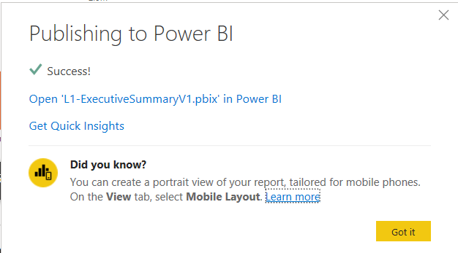
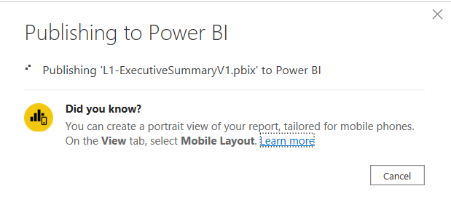
Publish to Power BI
.pbix report
Back in Power BI Desktop
open .pbix then Click Publish
Select My Workspace and click confirm.
Check success message
Goto www.powerbi.com
Open My Workspace
See you report
Navigate report

Slide 36
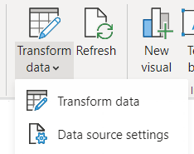
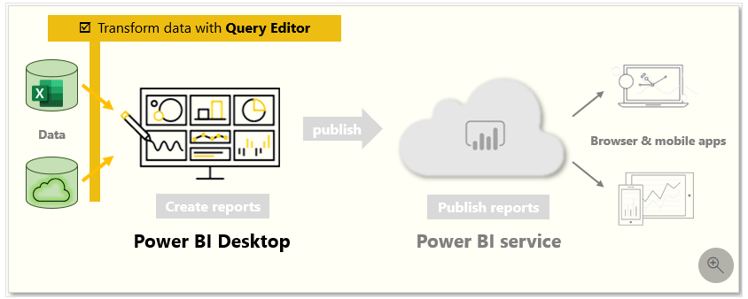
Power BI Week 2
Monday 25th Jan 2021
Use Power Query Editor to get data & prepare your data
Back to get & prepare data with Power Query Editor
From Power BI Desktop open Power Query Editor...how ?
Show PQE features
Power Query Language = M
BTW it’s the same in Excel
Get data & transform as demo in Learn

Slide 37
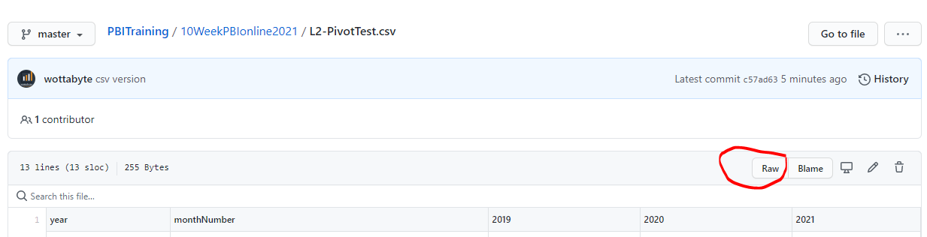
Power BI Week 2
Power Query Editor: Capitalize & UNpivot data demo
Csv > raw ? See url : https://github.com/wottabyte/PBITraining/tree/master/10WeekPBIonline2021
PQE use Web
Lowercase then capitalize
Pivot years
Close & Apply

Slide 38
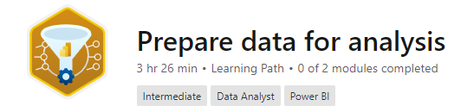
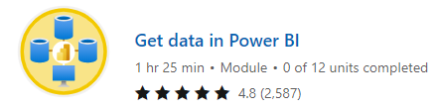
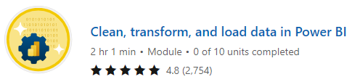
Power BI Week 2 CourseWork
Monday 25th Jan 2021
Microsoft Learn - Complete Learning Path ‘Prepare Data for analysis’
Module – ‘Get data in Power BI
Module – ‘Clean, transform and load data in Power BI
Download the slides from GitHub
https://docs.microsoft.com/en-us/learn/paths/prepare-data-power-bi/

Slide 39
Social Media : Meetup , LinkedIN, YouTube
@wottabyte
wottabyte
www.wottabyte.com

Slide 40
You Tube
https://www.youtube.com/channel/UCDtmmwK3YxWqzDNZ5L3pdMw

Slide 41
Power BI Week 3
1st February
Use Power BI desktop to structure & create datamodels
Watch your email & social media channels for when event goes live for registration.

Slide 42
The End

Slide 43
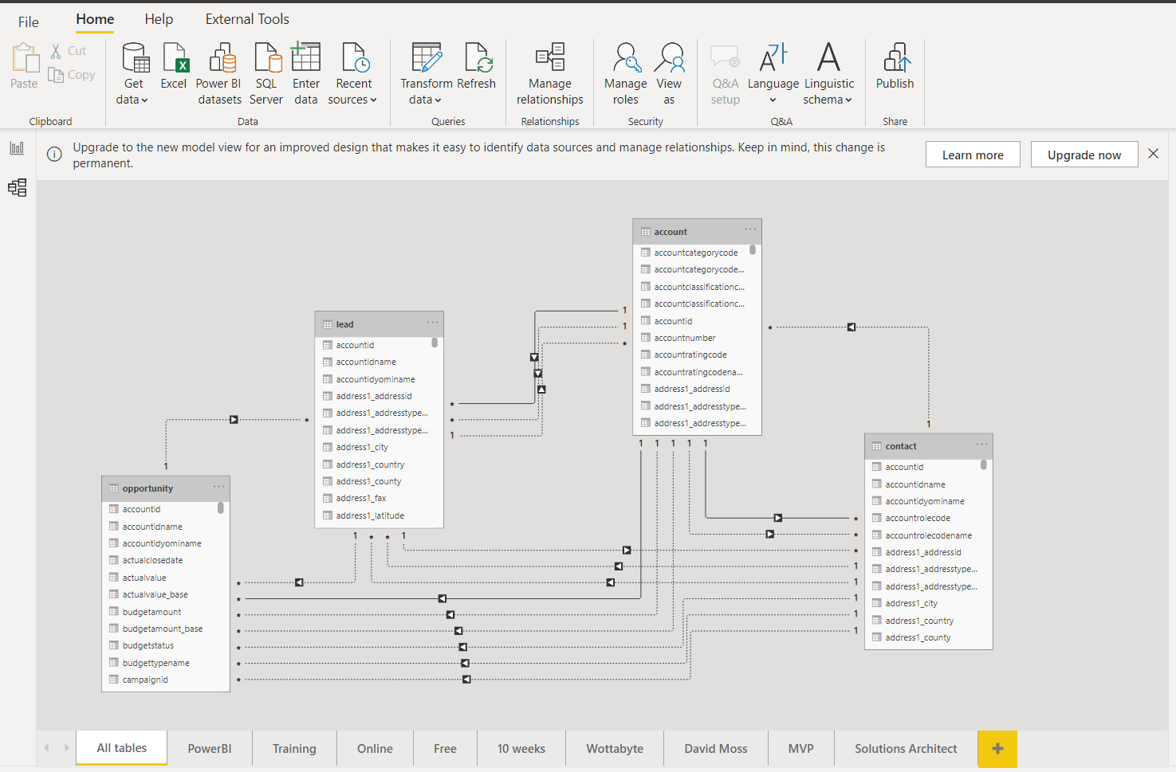
Power BI – LESSON 3 of 10
beginners free 10 weeks online training course

Slide 44
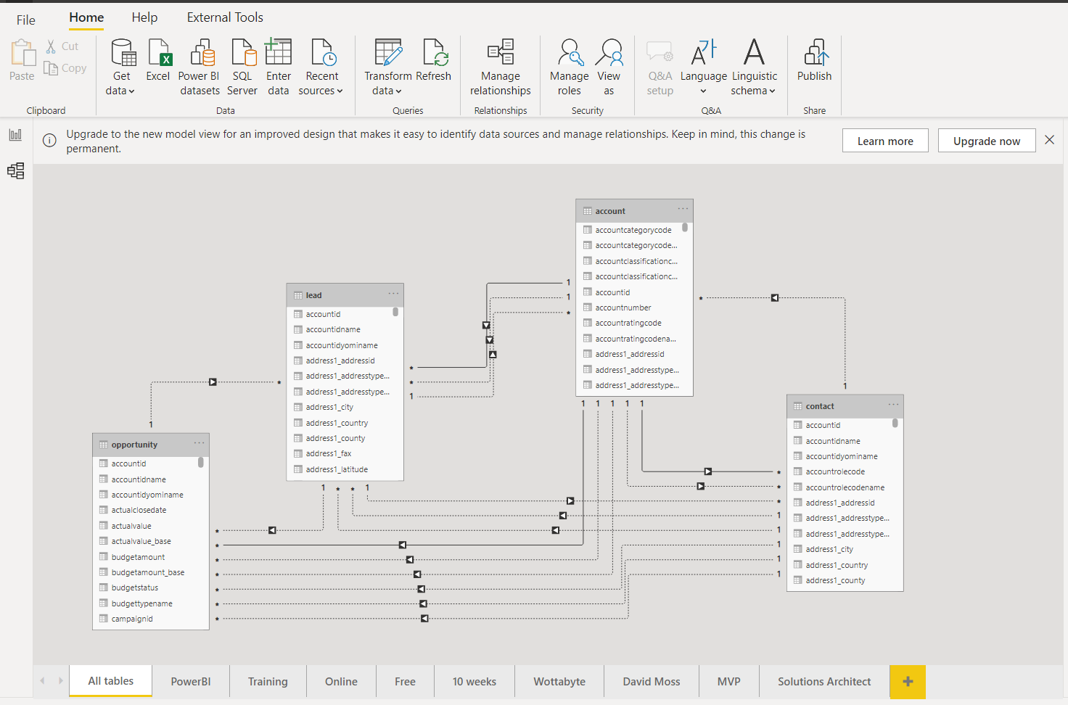
Power BI Week 3
Monday 1st Feb 2021
Use Power BI desktop to structure & create datamodels

Slide 45
Power BI Week 3
Monday 1st Feb 2021
Use Power BI desktop to structure & create datamodels
Hi & Intros: David, Conrad (get ready to scan Linkedin QR code)
Logistics: Classroom course
Recording on Youtube. Leave if not happy to be recorded
Each week sign up on Meetup.com for the weekly event & Q&A workshop
Each session will be a new Zoom link
Questions into the chat or raise your hand
2 screens is better than 1.
Microphones on mute

Slide 46
Linkedin : QR Codes

Slide 47
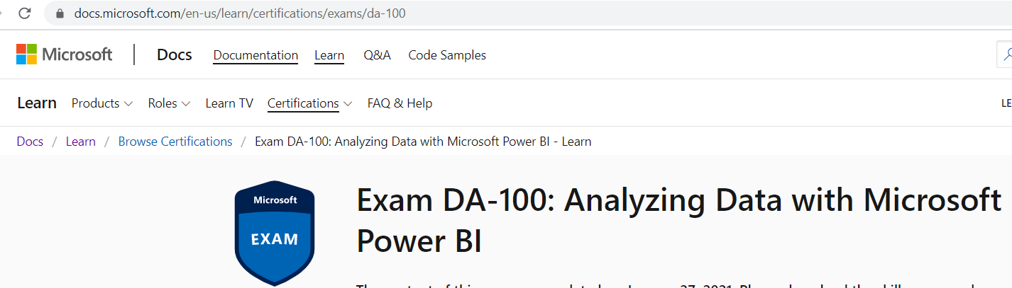
Microsoft Power BI Associate
DA-100 Certification
https://docs.microsoft.com/en-us/learn/certifications/exams/da-100
YOU Tube DA-100 : https://www.youtube.com/watch?v=CI7hdjq0ZxI

Slide 48

Workshop this eve at 21:00 – 22:00 GMT
Monday 1st Feb 2021
Q&A Workshop 3 - Power BI Beginner Training
https://www.meetup.com/The-Power-BI-Apprentice/events/276011703/

Slide 49
Power BI
beginners free 10 weeks online training course
Week 1: Monday 18th Jan 2021 : Introduction to Power BI and your first Power BI report.
Week 2: Monday 25th Jan 2021 : Use Power Query Editor to get data & prepare your data.
Week 3: Monday 1st Feb 2021 : Use Power BI desktop to structure & create datamodels.
Week 4: Monday 8th Feb 2021 : Design & configure Power BI visuals like charts, maps & KPIs.
Week 5: Monday 15th Feb 2021 : Add user friendly report navigation features, slicers & tooltips.
Week 6: Monday 22nd Feb 2021: Publish & share Power BI reports & dashboards.
Week 7: Monday 1st March 2021: Get to grips with Power BI cloud service & mobile features.
Week 8: Monday 8th March 2021: Enhance your data with DAX for KPIs reporting.
Week 9: Monday 15th March 2021: Data analytics reporting & AI features in Power BI.
Week 10: Monday 22nd March 2021: Power BI at work with workspaces, datasets & security.

Slide 50
What is Power BI ?

Slide 51
Power BI Week 2 CourseWork
From Monday 25th Jan 2021
Microsoft Learn - Complete Learning Path ‘Prepare Data for analysis’
Module – ‘Get data in Power BI
Module – ‘Clean, transform and load data in Power BI
Download the slides from GitHub
https://docs.microsoft.com/en-us/learn/paths/prepare-data-power-bi/

Slide 52
Power BI Week 3
Power BI Workflow

Slide 53
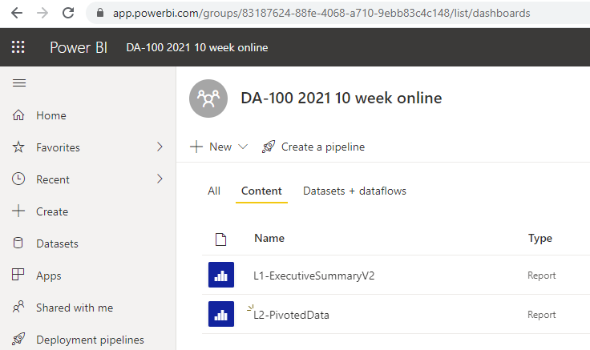
Power BI Week 2
Published to Power BI Service ??

Slide 54
Power BI Week 3
Power BI Workflow

Slide 55
Quick Survey of audience
https://forms.office.com/Pages/ResponsePage.aspx?id=WkuituyrDEaGarPmYT9Z1NvMNOjKOFdHsnEJjP6WpoNUREdYRjdPUUQ0SzlQVzYzUEdJSkVKV1U5Ni4u
Student go to form and submit
Trainer display live online results in Power BI dashboard

Slide 56
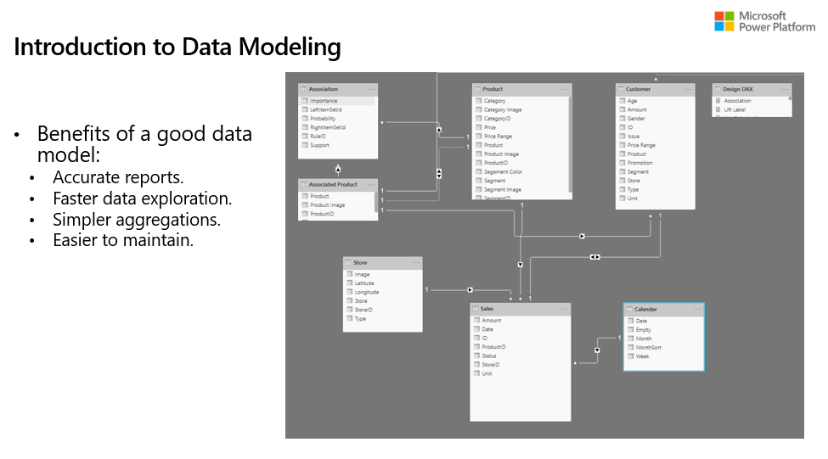
Power BI Week 3
Intro to data modelling

Slide 57
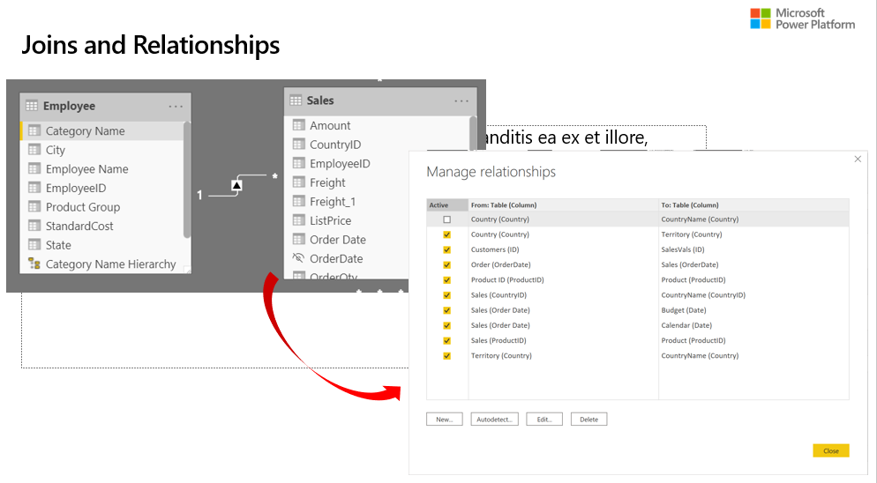
Power BI Week 3
Joins & Relationships

Slide 58
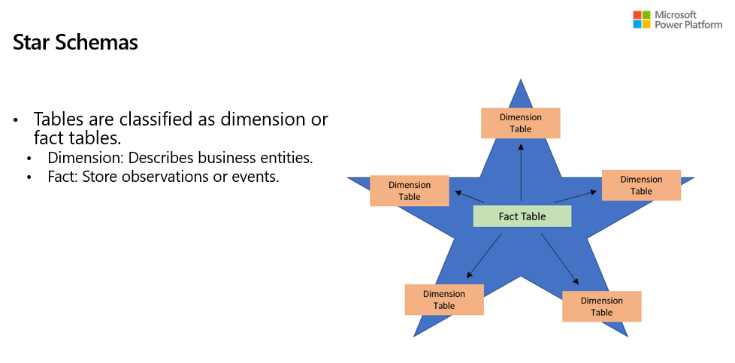
Power BI Week 3
Star Schemas

Slide 59

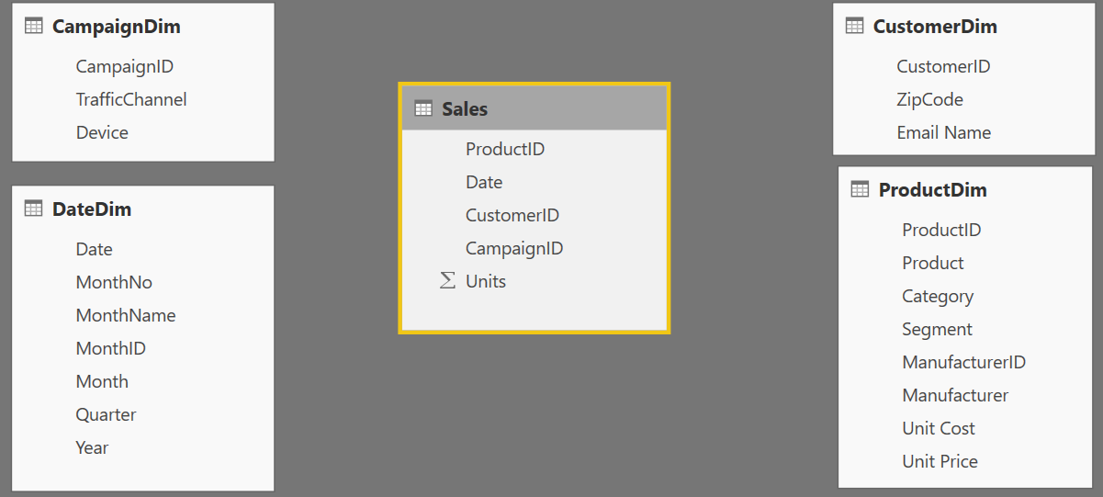
Components of a data model – Fact Table
Fact
Table
Fact Table
Contains Measures (or items to be aggregated) of a business process Examples:
Transactions
Sales Revenue
Units
Cost
Measures are usually sliceable.
Examples: By Month,
By Customer

Slide 60
Components of a data model – Dim Table
Dim
Table
Dim
Tables
Dim
Table
Dim
Tables
Dim Table
A Dim (or Dimension) table contains descriptive attributes that define how a fact should roll up.
Examples:
By month, By Customer, By Geo
Notes:
The dimensional attributes that we will use to describe the facts.

Slide 61

Components of a data model - Relationships
Relationships
Connection between a 2 tables (usually fact & Dim tables) using columns from each
3 kinds of Relationships
1 to Many
1 to 1
Many to Many
(with a bridge table)
Relationships
Relationships
Notes:
A Relationship is analogous to how an Excel VLOOKUP function brings two tables together
Can observe which side is the many (*) and which is the one (1) - CARDINALITY
When you draw the relationship, Desktop does several heuristic things
It checks that one side of the relationship is the “One” and the other is the “Many”
Directions of Relationship
Uni-directional are created by default and allows filters to get passed from attribute (dim) table to the Fact
Bi-Directional relationship allow you to pass filters in both directions
This is different than Many to Many
There is a significant performance penalty for Bi-Directional filtering

Slide 62
Data Model Brings Facts and Dimensions Together
Type of Data Models
Star Schema
Snowflake Schema
Flat or Denormalized
Note: This is not an exhaustive list, but are the most common model types used by Power BI.

Slide 63
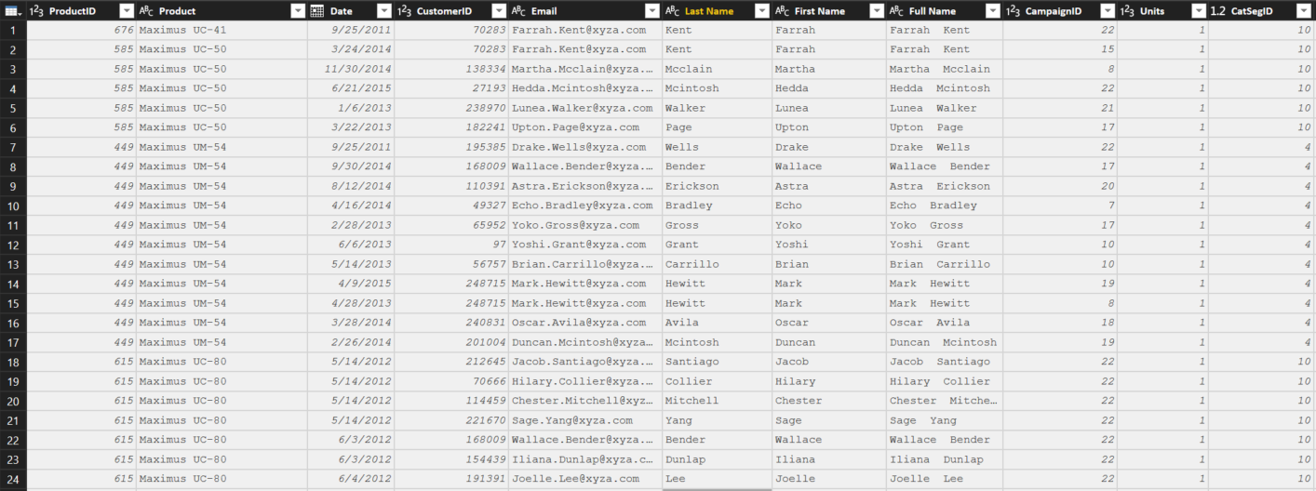
Flat or Denormalized Schema
All attributes for model exist in a single table
Highly inefficient
Model has extra copies of data > slow performance
Size of a flat table can blow up really quickly as data model becomes complex
Notes:
Similar to Excel with many V-Lookups
Denormalized are flattened versions where all attributes are copied into the same table

Slide 64
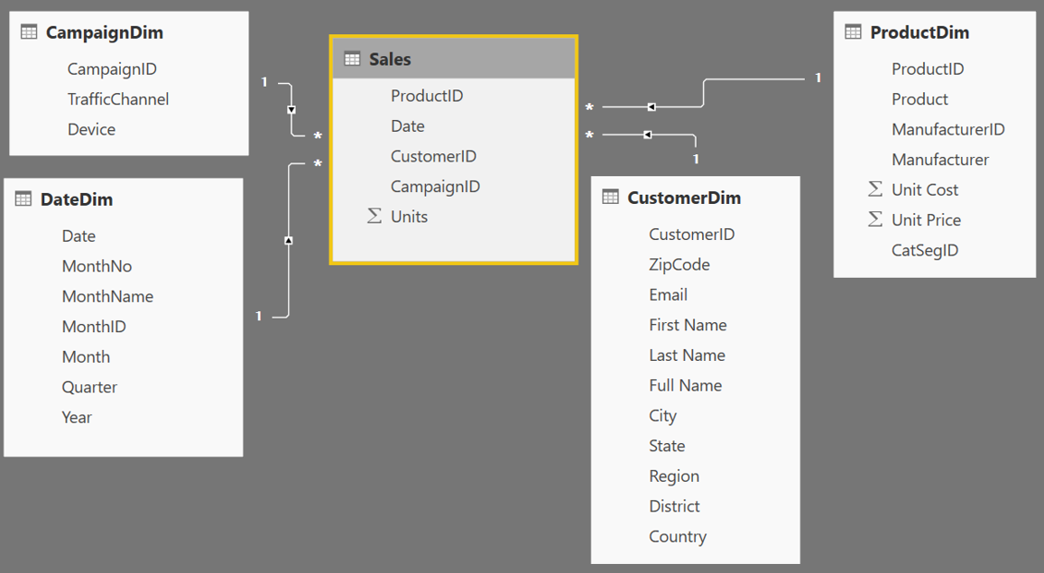
Star Schema
Fact table in the middle
Surrounded by Dims
Looks like a ‘Star’
Fact table is the “Many” side of the (one to many) relationship
1
1
1
Many
1
1
Many
Notes:
By extracting the repeated attributes to dimension tables, you are lowering the amount of memory required by the data model.

Slide 65
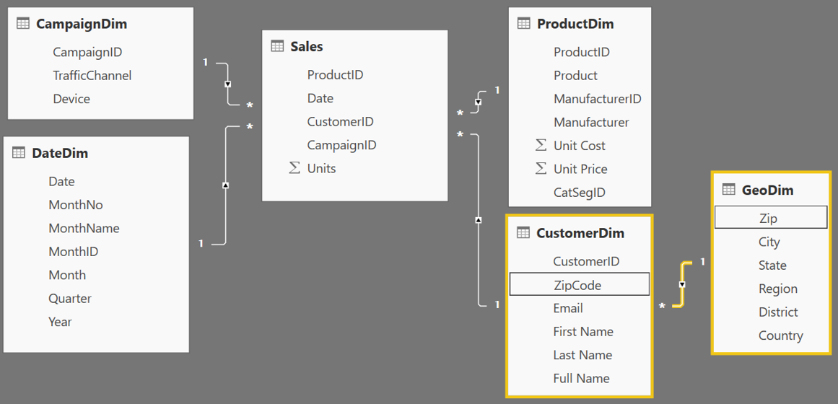
Snowflake Schema
Center is a Star schema
Fact table in middle
Surrounded by Dims
Dims “snowflake” off of other Dims
If you have many, it looks like a ‘Snowflake’
Dim or Fact tables can be the “Many” side of the relationship
Dims
Facts
Dims
Flake
Snowflake
Notes:
“Snowflaking” off tables can be very beneficial when your dimensions have several repeating attributes that can be extracted to their own table.
A zip code is associated with multiple attributes
Talk about your own zip code and the richness associated with that particular zip

Slide 66
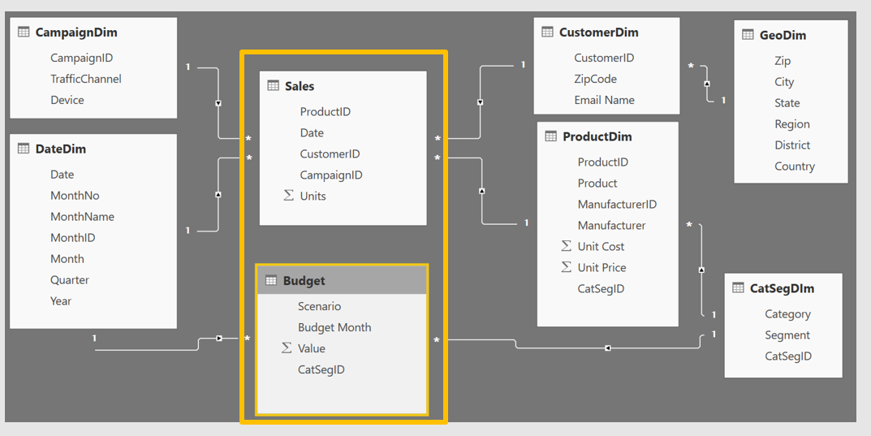
Granularity & Multiple Fact Tables
Grain (granularity) measures the level of detail in a table
Example:
One row per order or per Item
Daily or Monthly date grain
If your facts have very different granularities, split them into Multiple Fact tables & connect them to shared dimensions at the lowest common granularity.
Sales (Daily by Product)
Budget (Monthly by Product Category & Product Segment)
Notes:
Keep in mind, your measures (calculations) should be placed on a fact table, but it really does not matter which one. The key is that measures should not be placed on dimension tables.
When you have a fact at the Month grain, like budget, you can create a calculated column which holds the first (or last) day of the month to use in creating the relationship.

Slide 67
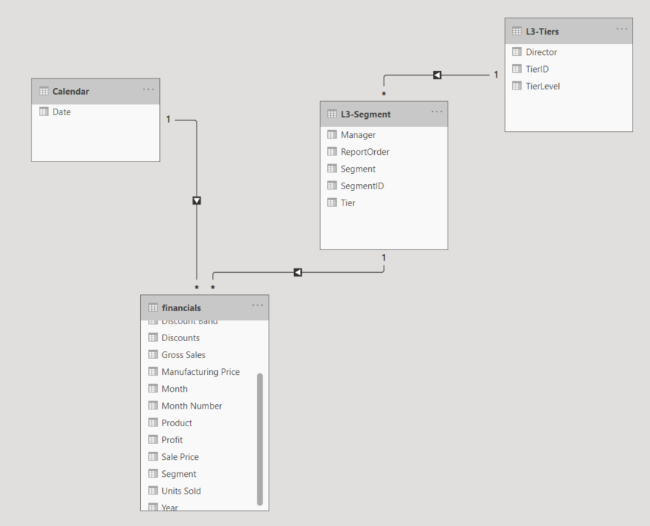
Power BI Week 3
Use Datamodel from Lesson 1
DEMO
Add Segment & Tiers dimensions
Use web connector with Raw csv url from GitHub
Create Star Schema
Create a report with Dimensional data
Hide related fields in fact [financials](Segment)
& in L3-Segment[Tier]
Segments: https://raw.githubusercontent.com/wottabyte/PBITraining/master/10WeekPBIonline2021/L3-Segment.csv
Tiers: https://raw.githubusercontent.com/wottabyte/PBITraining/master/10WeekPBIonline2021/L3-Tiers.csv

Slide 68
Power BI Week 3
Intro to DAX – Data Analysis Expressions
DAX is a library of functions & operators
Used to Calculated Columns, Measures & Calculated Tables.
Demo CC : Add to date table from lesson 1
DAX: Year
DAX: Month Number
DAX:FY = "FY" & YEAR('Calendar'[Date])
DAX:mmyyy = FORMAT('Calendar'[Date],"mmm") & "'" & RIGHT(YEAR('Calendar'[Date]),2)
Datamodel fix month order by adding month number
Fix mmmyy order by adding
yyyymm = 'Calendar'[year]*100 + 'Calendar'[month number]
Notes:
Month fix in Data view use Sort by month number
Remember : To use a date format (like "MMM" for month name), you need to pass the function a proper date. Not just an int (unless the int represents the full date, not just the month part).

Slide 69
Power BI Week 3
Measures
Measures:
Demo Default summarization then
Demo Measure : Total Revenue = sum of Sales
Demo Calculate : Sales by a fixed Country = “France”
Demo Sales by Country
If time go onto Time Intelligence
Time Intelligence
Demo Sales Previous Year & TOTALYTD & %
More DAX: Userelationships, semi additive,
Notes:
DAX helper
Total Sales = SUM(financials[ Sales])
Sales France = CALCULATE([Total Sales],financials[Country]="France")
Sales All = CALCULATE([Total Sales], ALL(financials))
Sales % = DIVIDE([Total Sales],[Sales All])
Sales SPLY = CALCULATE([Total Sales], SAMEPERIODLASTYEAR('Calendar'[Date]))
Sales TotalYTD = TOTALYTD([Total Sales],'Calendar'[Date])
Sales YTD = CALCULATE([Total Sales], DATESYTD('Calendar'[Date]))
Sales QTD = CALCULATE([Total Sales], DATESQTD('Calendar'[Date]))

Slide 70
Power BI Week 3
Template

Slide 71
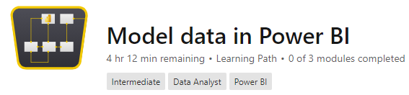
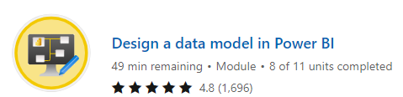
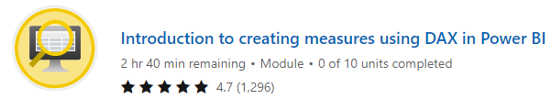
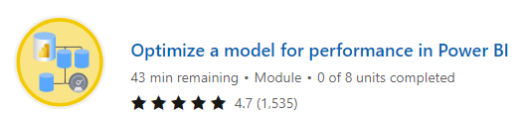
Power BI Week 3 CourseWork
Monday 1st Feb 2021
Microsoft Learn – ‘Model Data in Power BI’
Module – ‘Design a data model in Power BI’
Module – ‘Clean, transform and load data in Power BI
https://docs.microsoft.com/en-us/learn/paths/model-power-bi/

Slide 72
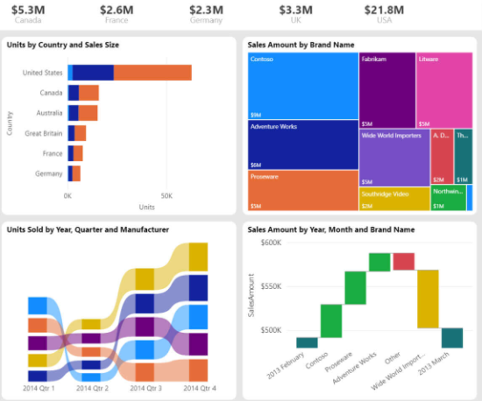
Lesson 3 of 10 Power BI free online training
POWER BI
BEGINNER
DATAMODELLING
TECHNIQUES
MONDAY 1st FEB
17:00 GMT

Slide 73
Q&A Workshop 3
POWER BI
BEGINNER
DATAMODELLING
TECHNIQUES
MONDAY 1st FEB
17:00 GMT

Slide 74
Power BI Week 3
Template

Slide 75
Lesson 4 of 10 Power BI Beginner
Power BI Reports & configure charts
MONDAY 8th FEB
17:00 GMT

Slide 76
Lesson 4 of 10 Power BI Beginner
Power BI Reports & charts
MONDAY 8th FEB 17:00 GMT

Slide 77
Power BI – LESSON 4 of 10
beginners free 10 weeks online training course

Slide 78
Power BI Week 4
Monday 8th Feb 2021
Design & configure Power BI visuals like charts, maps & KPIs
Hi & Intros: David, Conrad (get ready to scan Linkedin QR code)
Logistics: Classroom course
Recording on Youtube. Leave if not happy to be recorded
Each week sign up on Meetup.com for the weekly event & Q&A workshop
Each session will be a new Zoom link
Questions into the chat or raise your hand
2 screens is better than 1.
Microphones on mute

Slide 79
Linkedin : QR Codes

Slide 80
Microsoft Power BI Associate
DA-100 Certification
https://docs.microsoft.com/en-us/learn/certifications/exams/da-100
YOU Tube DA-100 : https://www.youtube.com/watch?v=CI7hdjq0ZxI

Slide 81

Workshop this eve at 21:00 – 22:00 GMT
Monday 8th Feb 2021
Q&A Workshop 4 - Power BI Beginner Training
https://www.meetup.com/The-Power-BI-Apprentice/events/276167984/

Slide 82
Power BI
beginners free 10 weeks online training course
Week 1: Monday 18th Jan 2021 : Introduction to Power BI and your first Power BI report.
Week 2: Monday 25th Jan 2021 : Use Power Query Editor to get data & prepare your data.
Week 3: Monday 1st Feb 2021 : Use Power BI desktop to structure & create datamodels.
Week 4: Monday 8th Feb 2021 : Design & configure Power BI visuals like charts, maps & KPIs.
Week 5: Monday 15th Feb 2021 : Add user friendly report navigation features, slicers & tooltips.
Week 6: Monday 22nd Feb 2021: Publish & share Power BI reports & dashboards.
Week 7: Monday 1st March 2021: Get to grips with Power BI cloud service & mobile features.
Week 8: Monday 8th March 2021: Enhance your data with DAX for KPIs reporting.
Week 9: Monday 15th March 2021: Data analytics reporting & AI features in Power BI.
Week 10: Monday 22nd March 2021: Power BI at work with workspaces, datasets & security.

Slide 83
What is Power BI ?

Slide 84
Power BI Last Week
Did you do the CourseWork ?
Microsoft Learn – ‘Model Data in Power BI’
Module – ‘Design a data model in Power BI’
Module – ‘Clean, transform and load data in Power BI
https://docs.microsoft.com/en-us/learn/paths/model-power-bi/

Slide 85
Power BI Week 4
Power BI Workflow

Slide 86
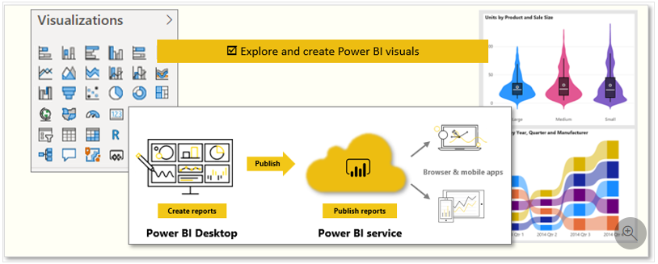
Power BI Week 4
Power BI Reports

Slide 87
Quick Survey of audience
https://forms.office.com/Pages/ResponsePage.aspx?id=WkuituyrDEaGarPmYT9Z1NvMNOjKOFdHsnEJjP6WpoNUREdYRjdPUUQ0SzlQVzYzUEdJSkVKV1U5Ni4u
Student go to form and submit
Trainer display live online results in Power BI dashboard

Slide 88
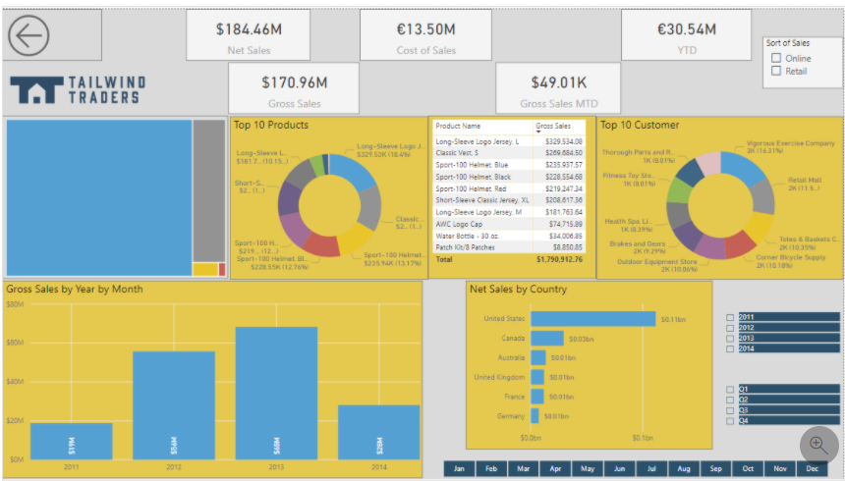
Power BI Week 4
Before

Slide 89
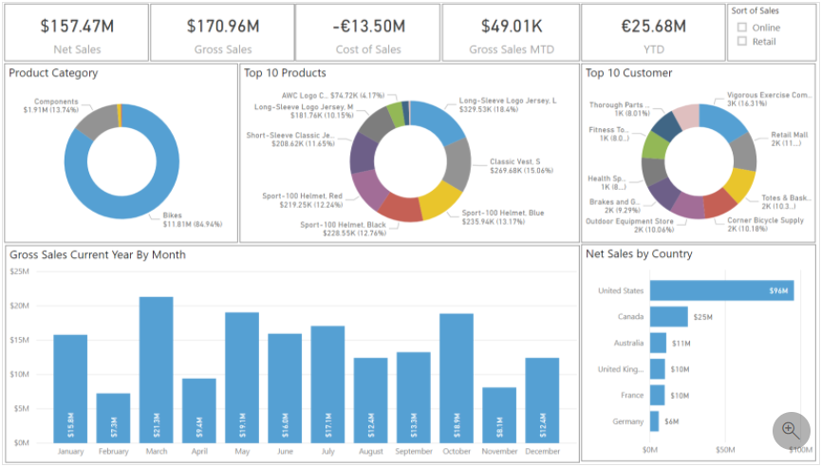
Power BI Week 4
After

Slide 90
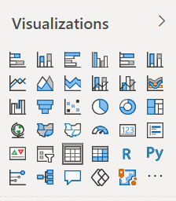
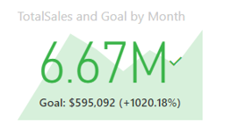
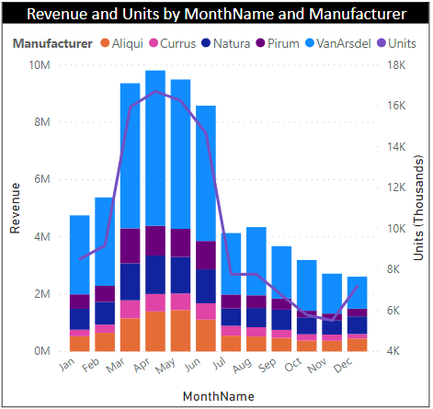






Power BI Week 4
Visual types & formatting
Table & matrix visuals
Bar & Column charts
Line & Area
Pie, Donut & Treemaps
Combo charts
Cards, multi-row card
Funnel
Gauge chart
Waterfall
Scatter chart
Maps – (Arc GIS)
Slicers
Q&A
DEMO FILE with all visuals configured
Format & configure visualizations: paintbrush

Slide 91

























Choose the Right Charts for the Right Purpose
Comparison
Composition
Trend
Distribution
Status
Geographic
Relationships
Slicing/Filtering
Stacked Bar
Tree
Line
Scatter Plot
KPI
Map
Area
Clustered Bar
Pie
Funnel
Bubble
Gauge
Filled Map
Bubble
Clustered Column
Stacked Area
Line and Stacked Column
Map
Multi-row Card
Table
100% Stacked Column
Stacked Column
Card
Matrix
Water Fall
Notes:
Demo- go through some scenarios and when to use.
(Image Source: Slalom under contract with Microsoft)

Slide 92


Power BI Week 4
More Visuals
Custom Visuals : Bullet Chart : view Appsource
Next week: Add user friendly report navigation features, slicers & tooltips

Slide 93
Power BI Week 4
Page Design Layout & Themes
Design with sketch (blank visuals) : layout
Configure report page : page info, size, wallpaper, background
Number of visuals
Position , align & Size
Titles
Data Labels
Markers (eg on lines)

Slide 94
Original Report
MAIN KPIs
KPIs DETAILS
TIER 2
INDICATORS
PROPORTIONS
Notes:
As discussed earlier, create a layout first

Slide 95
Use Storyboarding to Design Report Layout
Slicers
Logo Subject
When?
Who?
Where?
What?
Control this space. If all objects tell the same story, use the same gap space. If some objects tell a different story, make the gap bigger
Notes:
Use Storyboarding to get a sense of the story that will playout to provide answers to the Top Questions.
The more related the two story points are the lesser the spacer.

Slide 96




Storyboarding Tools
Install the Storyboarding Toolbar: https://docs.microsoft.com/en-us/vsts/work/backlogs/office/storyboard-your-ideas-using-powerpoint
Notes:
The Storyboarding Add-in has been included in updates to PowerPoint in Office 2013 and 2016. It has both charting objects as well as icons and other useful objects.
There are also more storyboard objects available online.

Slide 97

Power BI Week 4
Page Design Layout & Themes
Themes
Edit current theme
Import a theme .pbit
https://docs.microsoft.com/en-us/power-bi/create-reports/desktop-report-themes

Slide 98
Power BI Week 4
Nearly finished your report

Slide 99
Power BI Week 4
Publish reports to the Power BI Service

Slide 100




Power BI Week 4
Report in Service
View report in Service
Comment on reports
Interact with visual in the PBI service
…
Chat in teams, add a comment.

Slide 101



Power BI Week 4 CourseWork
Monday 8th Feb 2021
Microsoft Learn – ‘Visualize data in Power BI’
Module – ‘Work with Power BI visuals’
Keen ? Module – ‘Create a data driven story with Power Bi reports. Try it in prep for Week 5
https://docs.microsoft.com/en-us/learn/paths/visualize-data-power-bi/

Slide 102
Microsoft Power BI Associate
DA-100 Certification
https://docs.microsoft.com/en-us/learn/certifications/exams/da-100
YOU Tube DA-100 : https://www.youtube.com/watch?v=CI7hdjq0ZxI

Slide 103
Social Media : Meetup , LinkedIN, YouTube
@wottabyte
wottabyte
www.wottabyte.com

Slide 104

You Tube
https://www.youtube.com/channel/UCDtmmwK3YxWqzDNZ5L3pdMw
https://youtu.be/dW08MYqbJ7k

Slide 105
Workshop this eve at 21:00 – 22:00 GMT
Monday 8th Feb 2021
Q&A Workshop 4 - Power BI Beginner Training
https://www.meetup.com/The-Power-BI-Apprentice/events/276167984/

Slide 106
Power BI
beginners free 10 weeks online training course
Week 1: Monday 18th Jan 2021 : Introduction to Power BI and your first Power BI report.
Week 2: Monday 25th Jan 2021 : Use Power Query Editor to get data & prepare your data.
Week 3: Monday 1st Feb 2021 : Use Power BI desktop to structure & create datamodels.
Week 4: Monday 8th Feb 2021 : Design & configure Power BI visuals like charts, maps & KPIs.
Week 5: Monday 15th Feb 2021 : Add user friendly report navigation features, slicers & tooltips.
Week 6: Monday 22nd Feb 2021: Publish & share Power BI reports & dashboards.
Week 7: Monday 1st March 2021: Get to grips with Power BI cloud service & mobile features.
Week 8: Monday 8th March 2021: Enhance your data with DAX for KPIs reporting.
Week 9: Monday 15th March 2021: Data analytics reporting & AI features in Power BI.
Week 10: Monday 22nd March 2021: Power BI at work with workspaces, datasets & security.

Slide 107
NEXT WEEK : Power BI Week 5
15th February
Add user friendly report navigation features, slicers & tooltips.
Watch email & social media channels when event goes live 2 register.
Lesson 5 of 10 Power BI Beginner
Power BI user friendly reports
MONDAY 15th FEB 17:00 GMT

Slide 108
Coursework Lesson 4 of 10 Power BI Beginner
Power BI Reports & configure charts
Coursework explained

Slide 109
NEXT WEEK : Power BI Week 5
15th February
Add user friendly report navigation features, slicers & tooltips.
Watch email & social media channels when event goes live 2 register.
Lesson 5 of 10 Power BI Beginner
Power BI user friendly reports
MONDAY 15th FEB 17:00 GMT

Slide 110
Lesson 5 of 10 Power BI Beginner
Power BI user friendly reports
MONDAY 15th FEB 17:00 GMT
Use for LinkedIN Events pubblicity

Slide 111
Power BI Beginner - NOW
Power BI Q&A Workshop
MONDAY 15th FEB 21:00 GMT

Slide 112

Lesson 5 of 10 Power BI Beginner
Power BI navigation, buttons, drillthrough
MONDAY 15th FEB 17:00 GMT

Slide 113
Power BI – LESSON 5 of 10
beginners free 10 weeks online training course

Slide 114
Power BI Week 5
Monday 15th Feb 2021
Add user friendly report navigation features, slicers & tooltips.
Hi & Intros: David, Conrad (get ready to scan Linkedin QR code)
Logistics: Classroom course
Recording on Youtube. Leave if not happy to be recorded
Each week sign up on Meetup.com for the weekly event & Q&A workshop
Each session will be a new Zoom link
Questions into the chat or raise your hand
2 screens is better than 1.
Microphones on mute

Slide 115
Linkedin : QR Codes

Slide 116
Microsoft Power BI Associate
DA-100 Certification
https://docs.microsoft.com/en-us/learn/certifications/exams/da-100
YOU Tube DA-100 : https://www.youtube.com/watch?v=CI7hdjq0ZxI

Slide 117

Workshop this eve at 21:00 – 22:00 GMT
Monday 15th Feb 2021
Q&A Workshop 5 - Power BI Beginner Training
https://www.meetup.com/The-Power-BI-Apprentice/events/276303046/

Slide 118
Power BI
beginners free 10 weeks online training course
Week 1: Monday 18th Jan 2021 : Introduction to Power BI and your first Power BI report.
Week 2: Monday 25th Jan 2021 : Use Power Query Editor to get data & prepare your data.
Week 3: Monday 1st Feb 2021 : Use Power BI desktop to structure & create datamodels.
Week 4: Monday 8th Feb 2021 : Design & configure Power BI visuals like charts, maps & KPIs.
Week 5: Monday 15th Feb 2021 : Add user friendly report navigation features, slicers & tooltips.
Week 6: Monday 22nd Feb 2021: Publish & share Power BI reports & dashboards.
Week 7: Monday 1st March 2021: Get to grips with Power BI cloud service & mobile features.
Week 8: Monday 8th March 2021: Enhance your data with DAX for KPIs reporting.
Week 9: Monday 15th March 2021: Data analytics reporting & AI features in Power BI.
Week 10: Monday 22nd March 2021: Power BI at work with workspaces, datasets & security.

Slide 119
What is Power BI ?

Slide 120
Power BI Week 5
Add user friendly report navigation features, slicers & tooltips.
Use Power BI features to tell a Story:
So much will split it over 2 weeks
Conditional formatting
Report Navigation with buttons
Drillthrough
Edit interactions
Slicer, filter & sorting
Sync slicers
Bookmark and Selection panel
Custom tooltips

Slide 121

Power BI Week 5
Conditional Formatting
Conditional Formatting – show where and then see other slides for formatting techniques.
Demo on CY-SPLY
https://docs.microsoft.com/en-us/power-bi/create-reports/desktop-conditional-table-formatting

Slide 122

Power BI Week 5
Report Navigation with Buttons
Buttons : feels more like an app
Navigation : story telling good for App like navigation
Selections : hide & view & layer visuals
Demo:
Add a button, change action to ‘Navigation’ (back, bookmark, drillthrough, navigation, Q&A, weburl)
Advanced bonus : Create a button with measure to drive different page destinations (based on table column & slicer)
https://docs.microsoft.com/en-us/power-bi/create-reports/desktop-buttons

Slide 123
Power BI Week 5
Drillthrough
Drillthrough : high level drillthrough of an entity to a detailed report.
Advanced
Cross-report drillthrough (source & target) - configure your report to be the source. File>Options&Settings>Options>ReportSettings set to ‘Allow’ visuals in this…….
Next in target report set page report settings to Cross Report is On and populate fields value.
User can select Drillthrough : Page Name [ Report Name]
Overview report
Source
Filter Context
Detailed report
Target

Slide 124
Power BI Week 5
If time
If reach here in Lesson 5 then jump to Edit Interactions from Week 6
Do a resume of the course so far

Slide 125
Power BI Week 5
Template

Slide 126
Lesson 5 of 10 Power BI Beginner
Power BI report navigation slicers & tooltips
CourseWork Explained

Slide 127
Power BI Week 5 CourseWork
Monday 15th Feb 2021
Microsoft Learn – ‘Visualize data in Power BI’
Module – ‘Create a data driven story with Power Bi reports
https://docs.microsoft.com/en-us/learn/paths/visualize-data-power-bi/

Slide 128
Microsoft Power BI Associate
DA-100 Certification
https://docs.microsoft.com/en-us/learn/certifications/exams/da-100
YOU Tube DA-100 : https://www.youtube.com/watch?v=CI7hdjq0ZxI

Slide 129
Social Media : Meetup , LinkedIN, YouTube
@wottabyte
wottabyte
www.wottabyte.com

Slide 130


You Tube
https://www.youtube.com/channel/UCDtmmwK3YxWqzDNZ5L3pdMw
https://youtu.be/dW08MYqbJ7k

Slide 131
Workshop this eve at 21:00 – 22:00 GMT
Monday 15th Feb 2021
Q&A Workshop 5 - Power BI Beginner Training
https://www.meetup.com/The-Power-BI-Apprentice/events/276303046/

Slide 132
Power BI
beginners free 10 weeks online training course
Week 1: Monday 18th Jan 2021 : Introduction to Power BI and your first Power BI report.
Week 2: Monday 25th Jan 2021 : Use Power Query Editor to get data & prepare your data.
Week 3: Monday 1st Feb 2021 : Use Power BI desktop to structure & create datamodels.
Week 4: Monday 8th Feb 2021 : Design & configure Power BI visuals like charts, maps & KPIs.
Week 5: Monday 15th Feb 2021 : Add user friendly report navigation features, slicers & tooltips.
Week 6: Monday 22nd Feb 2021: More user friendly reports : Power BI slicers, bookmarks & custom tooltips
Week 7: Monday 1st March 2021: Publish & share Power BI reports & dashboards Get to grips with Power BI cloud service & mobile features.
Week 8: Monday 8th March 2021: Enhance your data with DAX for KPIs reporting.
Week 9: Monday 15th March 2021: Data analytics reporting & AI features in Power BI.
Week 10: Monday 22nd March 2021: Power BI at work with workspaces, datasets & security.

Slide 133
NEXT WEEK : Power BI Week 6
22nd February
Power BI report slicers & custom tooltips
Watch email & social media channels when event goes live 2 register.
Lesson 6 of 10 Power BI Beginner
Power BI slicers & custom tooltips
MONDAY 22nd FEB 17:00 GMT

Slide 134

Lesson 6 of 10 Power BI Beginner
Power BI slicers, bookmarks & custom tooltips
MONDAY 22nd FEB 17:00 GMT

Slide 135
Links
Youtube Lesson 5: https://www.youtube.com/watch?v=82E4IPdLSNE
Youtube courseworks Lesson 5: https://www.youtube.com/watch?v=e0xDgpeIm1M
Register Lesson 6: https://www.meetup.com/The-Power-BI-Apprentice/events/276348244/
Register Workshop 6: https://www.meetup.com/The-Power-BI-Apprentice/events/276348292/

Slide 136
LAST PAGE
Please ignore the remaining pages as they are part preparation for next sessions

Slide 137
Lesson 6 of 10 Power BI Beginner
Power BI slicers, bookmarks & custom tooltips
MONDAY 22nd FEB 17:00 GMT

Slide 138
Lesson 6 of 10 Power BI Beginner
Power BI slicers & custom tooltips
MONDAY 22nd FEB 17:00 GMT
https://okviz.com/blog/design-guide-for-power-bi-slicers-and-filters/

Slide 139
Power BI Beginner - NOW
Power BI Q&A Workshop 6
MONDAY 22nd FEB 21:00 GMT

Slide 140

Workshop this eve at 21:00 – 22:00 GMT
Monday 22nd Feb 2021
Q&A Workshop 6 - Power BI Beginner Training
https://www.meetup.com/The-Power-BI-Apprentice/events/276303046/

Slide 141
Power BI – LESSON 6 of 10
beginners free 10 weeks online training course
Publish , Share PBI reports, dashboards, Power BI service & mobile features

Slide 142
Power BI
beginners free 10 weeks online training course
Week 1: Monday 18th Jan 2021 : Introduction to Power BI and your first Power BI report.
Week 2: Monday 25th Jan 2021 : Use Power Query Editor to get data & prepare your data.
Week 3: Monday 1st Feb 2021 : Use Power BI desktop to structure & create datamodels.
Week 4: Monday 8th Feb 2021 : Design & configure Power BI visuals like charts, maps & KPIs.
Week 5: Monday 15th Feb 2021 : Add user friendly report navigation features, slicers & tooltips.
Week 6: Monday 22nd Feb 2021: More user friendly reports : Power BI slicers, bookmarks & custom tooltips
Week 7: Monday 1st March 2021: Publish & share Power BI reports & dashboards Get to grips with Power BI cloud service & mobile features.
Week 8: Monday 8th March 2021: Enhance your data with DAX for KPIs reporting.
Week 9: Monday 15th March 2021: Data analytics reporting & AI features in Power BI.
Week 10: Monday 22nd March 2021: Power BI at work with workspaces, datasets & security.

Slide 143
Power BI Week 6
Power BI report slicers & custom tooltips
Use Power BI features to tell a Story:
So much will split it over 2 weeks
LAST WEEK 5
Conditional formatting
Report Navigation with buttons
Drillthrough
THIS WEEK 6
Slicer, filter & sorting
Edit interactions
Sync slicers
Bookmark and Selection panel
Custom tooltips

Slide 144
Power BI Week 6
Slicer, Filter & Sorting
Slicing Filtering & Sorting
Filtering : remove data in pane
Slicer : slice data on canvas
Sorting : highlight values by like Top5
Demo
Slicer formatting for text or values slicers; dropdown, search , slider. Format single, multi all select.
Filters Pane: show hide, lock preselect, basic, advanced.
Filters on this visual, on this page, all pages. : Filters Drillthrough
Sort : ascending descending, field from …. Top right of a visual

Slide 145

Power BI Week 6
Edit Interactions
Edit Interactions
Configure a report with some slicers slicing right of page (detail) but not left of page (summary)
Use hierarchies to drive detail interactions

Slide 146
Power BI Week 6
Sync Slicers
Sync Slicers across pages

Slide 147

Power BI Week 6
Bookmarks & Selection panel
Bookmark like navigation but good for on same page changes
Bookmark panel : story telling good for PPT also for App like navigation
Selection panel : hide & view visuals
Demo:
Take a bookmark
Add a button, change action to ‘Bookmark’ (back, bookmark, drillthrough, navigation, Q&A, weburl)
Do bookmark to switch between donut and table on same page.

Slide 148
Power BI Week 6
Custom Tooltips
Custom Tooltips

Slide 149
Power BI Week 6 CourseWork
Monday 22nd Feb 2021
Microsoft Learn – ‘Visualize data in Power BI’
Same module as week 5 but do it all.
Module – ‘Create a data driven story with Power Bi reports
https://docs.microsoft.com/en-us/learn/paths/visualize-data-power-bi/

Slide 150
NEXT WEEK : Power BI Week 7
1st March
Publish , Share PBI reports, dashboards, Power BI service & mobile features
Watch email & social media channels when event goes live 2 register.
Lesson 7 of 10 Power BI Beginner
Publish & share Power BI reports friendly reports
MONDAY 1st MAR 17:00 GMT

Slide 151
Lesson 7 of 10 Power BI Beginner
Publish & share Power BI reports
MONDAY 1st March 17:00 GMT

Slide 152
Power BI Beginner - NOW
Power BI Q&A Workshop 7
MONDAY 1st March 21:00 GMT

Slide 153
Lesson 7 of 10 Power BI Beginner
Publish & share Power BI reports & dashboards
MONDAY 1st MARCH 17:00 GMT

Slide 154
Power BI Week 7
Publish , Share PBI reports, dashboards, Power BI service & mobile features
Combined here in week 7 the original week 6 & Week7.
Remember we split the original week 5 user friendly reports over both week 5 & week 6 and moved the original week 6 content into week 7 as makes an easier balance of content.

Slide 155
Power BI Week 7
Mobile Report
Mobile report
PBI desktop : View>Mobile Layout
Slicers : format>general>responsive for mobile

Slide 156
Power BI – LESSON 7 of 10
beginners free 10 weeks online training course

Slide 157


Power BI Week 7 CourseWork
Monday 1st March 2021
Microsoft Learn – ‘Visualize data in Power BI’
Module – Create dashboards in Power BI
Extra Module – Create paginated Reports
https://docs.microsoft.com/en-us/learn/paths/visualize-data-power-bi/

Slide 158
Power BI – LESSON 8 of 10
beginners free 10 weeks online training course

Slide 159
Power BI Week 8
Template

Slide 160
Power BI – LESSON 9 of 10
beginners free 10 weeks online training course

Slide 161
Power BI Week 9
Template

Slide 162

Power BI Week 9
Advanced Visuals
Custom Visuals : Bullet Chart : view Appsource
Create your own custom visual with Custom Visual SDK NodeJS .pbiviz
R or Python visuals
R CRAN IDE Rstudio r dataset
Python Anaconda pandas dataframe
Show off here an R Visual Hawaii
Also import R & Python custom visuals
Next week: Add user friendly report navigation features, slicers & tooltips

Slide 163
Power BI – LESSON 10 of 10
beginners free 10 weeks online training course

Slide 164
Power BI Week 10
Template

Slide 165
Power BI Week ?
Report Performance
Not for Beginners
Performance Analyzer
Tune Performance

Slide 166
Power BI Training
Links
YouTube Channel: https://www.youtube.com/channel/UCDtmmwK3YxWqzDNZ5L3pdMw
Meetup events: https://www.meetup.com/The-Power-BI-Apprentice/events/
GitHub files: https://github.com/wottabyte/PBITraining/tree/master/10WeekPBIonline2021
DA-100: https://docs.microsoft.com/en-us/learn/certifications/exams/da-100

Slide 167
W O T T A

Slide 168
B Y T E

